Slide 1
CSE 445 Lecture 2-3
Linear Algebra

Slide 2
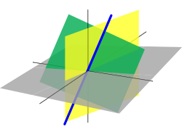
What is Linear Algebra
Linear algebra is the branch of mathematics concerning linear equations such as
a₁x₁+a₂x₂+ … … … +a_{n}x_{n} = b
In vector notation we say a^{T}x = b
Called a linear transformation of x
Linear algebra is fundamental to geometry, for defining objects such as lines, planes, rotations
Linear equations a^{T}x = b defines a plane in (x₁,x₂,… …,x_{n}) space
Straight lines define common solutions to equations

Slide 3
Why Linear Algebra?
Linear Algebra is used throughout engineering
Because it is based on continuous math rather than discrete math
Traditional CS curriculum embracing it increasingly
Essential for understanding ML algorithms
We convert input vectors (x₁, x₂, … …, x_{n}) into outputs by a series of linear transformation
In this course we discuss
Concepts of linear algebra needed for ML
Omit other aspects of linear algebra

Slide 4
Topics Covered
Scalars, Vectors, Matrices, Tensors
Matrix & Vector multiplication
Linear dependence & Span
Norms
Special matrices/vectors
Eigen decomposition
Singular Value Decomposition (SVD)
Moore–Penrose pseudoinverse
Trace & Determinant
Example: Principal Components Analysis (PCA)

Slide 5
Key concepts: Scalar
Single number
Just a number
In contrast to other objects in linear algebra, which are usually arrays of numbers
Represented in lower-case italic x
They can be real-valued or be integers
Let 𝒙 ε 𝓡 be the slope of the line
Defining a real valued scalar
Let 𝝶 ε 𝓝 be the number of units
Defining a natural number scalar

Slide 6
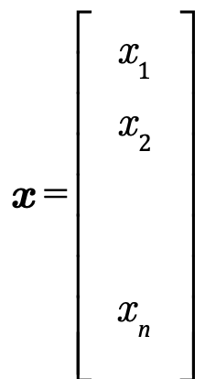
Key concepts: Vectors
An array of numbers arranged in order
Each number identified by an index
Written in lower-case bold such as x
Its elements are in italics lower case subscripted
If each element is in R then x is in R^{n}
We can think of vectors as points in space
Each element gives coordinate along an axis

Slide 7

Key concepts: Matrices
2-D array of numbers
So each element identified by two indices
Denoted by bold typeface A
Elements indicated by name in italic but not bold
A_{1,1} is the top left entry and A_{m,n} is the bottom right entry
We can identify numbers in vertical column j by using ":"
A_{i:} is i^{th} row of A, A_{:j} is the j^{th} column of A
If A has shape of height m and width n with real-values then

Slide 8
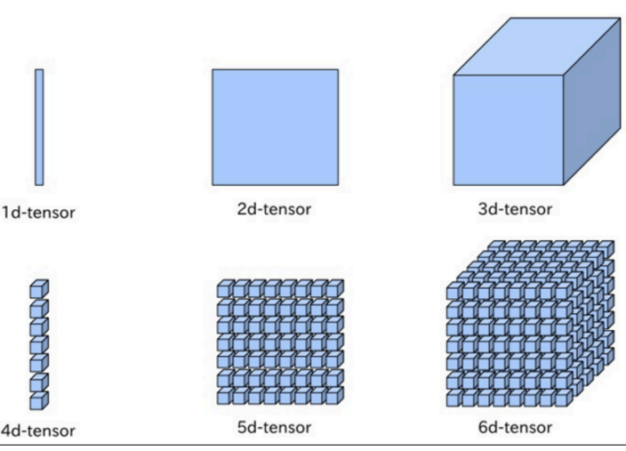
Key concepts: Tensors
Sometimes need an array with more than two axes
An RGB color image has three axes
A tensor is an array of numbers arranged on a regular grid with variable number of axes
Denote a tensor with this bold typeface: A
Element (i,j,k) of tensor denotated by A_{i,j,k}

Slide 9
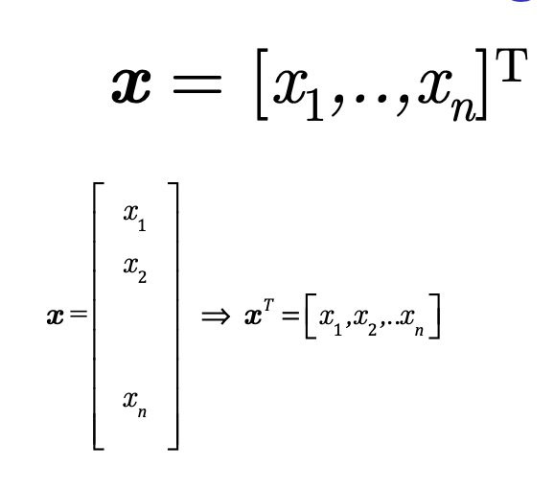
Vectors as special case of matrix
Vectors are matrices with a single column
Often written in-line using transpose
A scalar is a matrix with one element
a = a^{T}

Slide 10
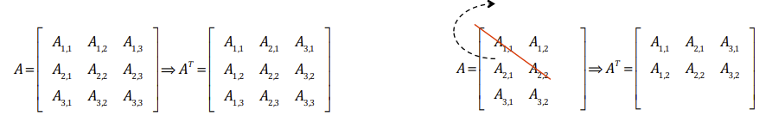
Transpose of a Matrix
An important operation on matrices
The transpose of a matrix A is denoted as A^{T}
Defined as
(A^{T})_{i,j} = A_{j,i}
The mirror image across a diagonal line
Called the main diagonal running down to the right starting from upper left corner

Slide 11
Matrix Addition/Subtraction
We can add matrices to each other if they have the same shape, by adding corresponding elements
If A and B have the same shape (height m, width n)
C = A+B ---> C_{i,j} = A_{i,j} + B_{i,j}
A scalar can be added to a matrix or multiplied by a scalar
D = aB + c ---> D_{i,j} = aB_{i,j} + c
Less conventional notation used in ML
Vector added to matrix
C = A + b ---> C_{i,j} = A_{i,j} + b_{j}
Called broadcasting since vector b added to each row of A

Slide 12
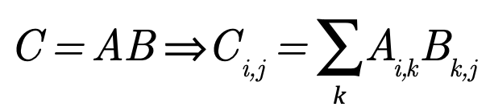

Multiplying Matrices
For product C=AB to be defined, A must have same number of columns as the number of rows of B
IF A is of shape mxn and B is of shape nxp then matrix product C is of shape mxp
Note that the standard product of two matrices is not just the product of two individual elements
Such a product does exist and is called the element wise product or Hadamard product

Slide 13
Multiplying Vectors
Dot product between two vectors x and y of same dimensionality is the matrix product x^{T}y
We can think of matrix product C=AB as computing C_{ij} - the dot product of row i of A and column j of B

Slide 14
Matrix Prodcut Properties
Distributivity over addition: A(B+C) = AB + AC
Associativity: A(BC) = (AB)C
Not commutative: AB = AB is not always true
Dot product between vectors is commutative: x^{T}y = y^{T}x
Transpose of a matrix product has a simple form: (AB)^{T} = B^{T}A^{T}

Slide 15
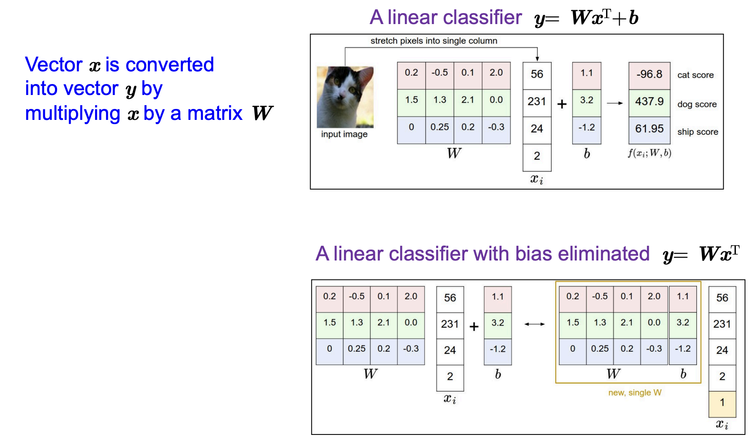
Example of tensors in ML

Slide 16
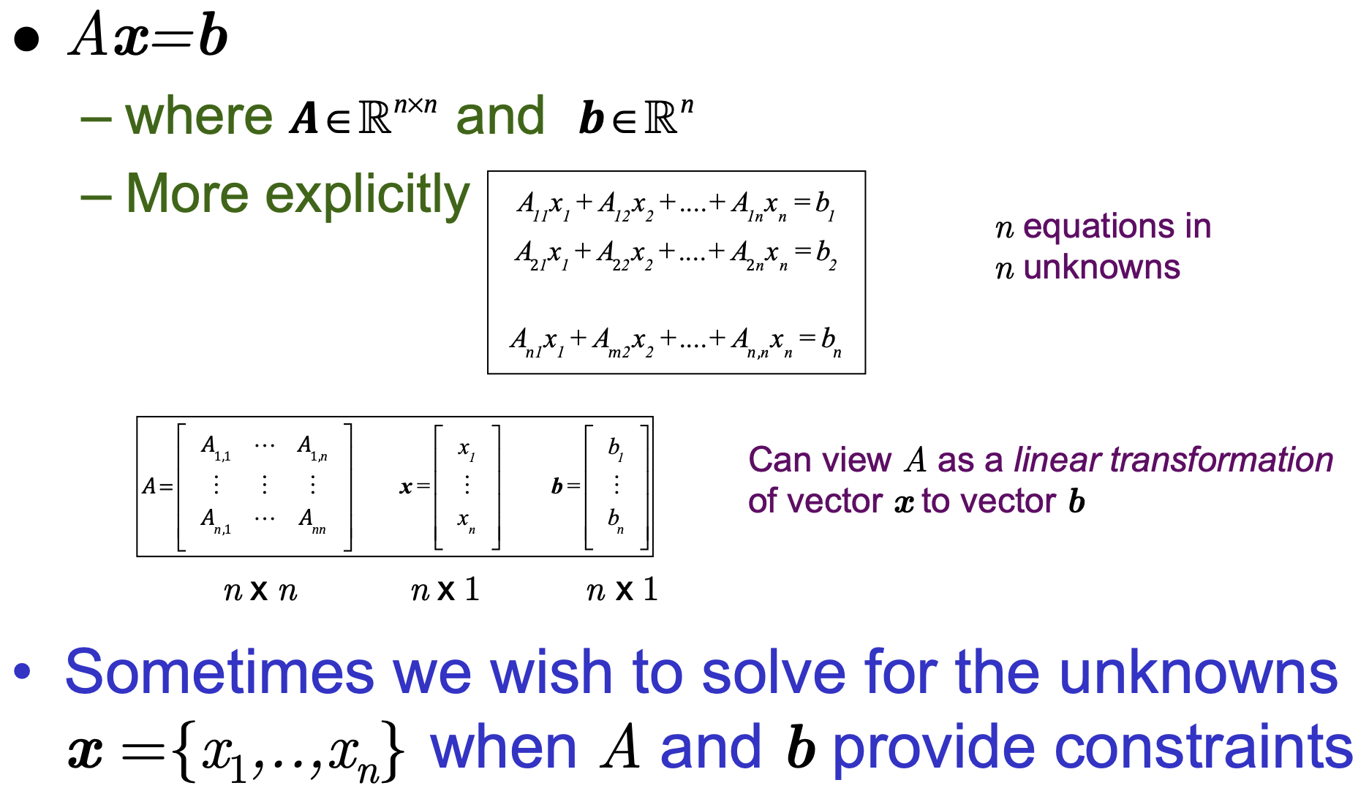
Linear Transformations

Slide 17
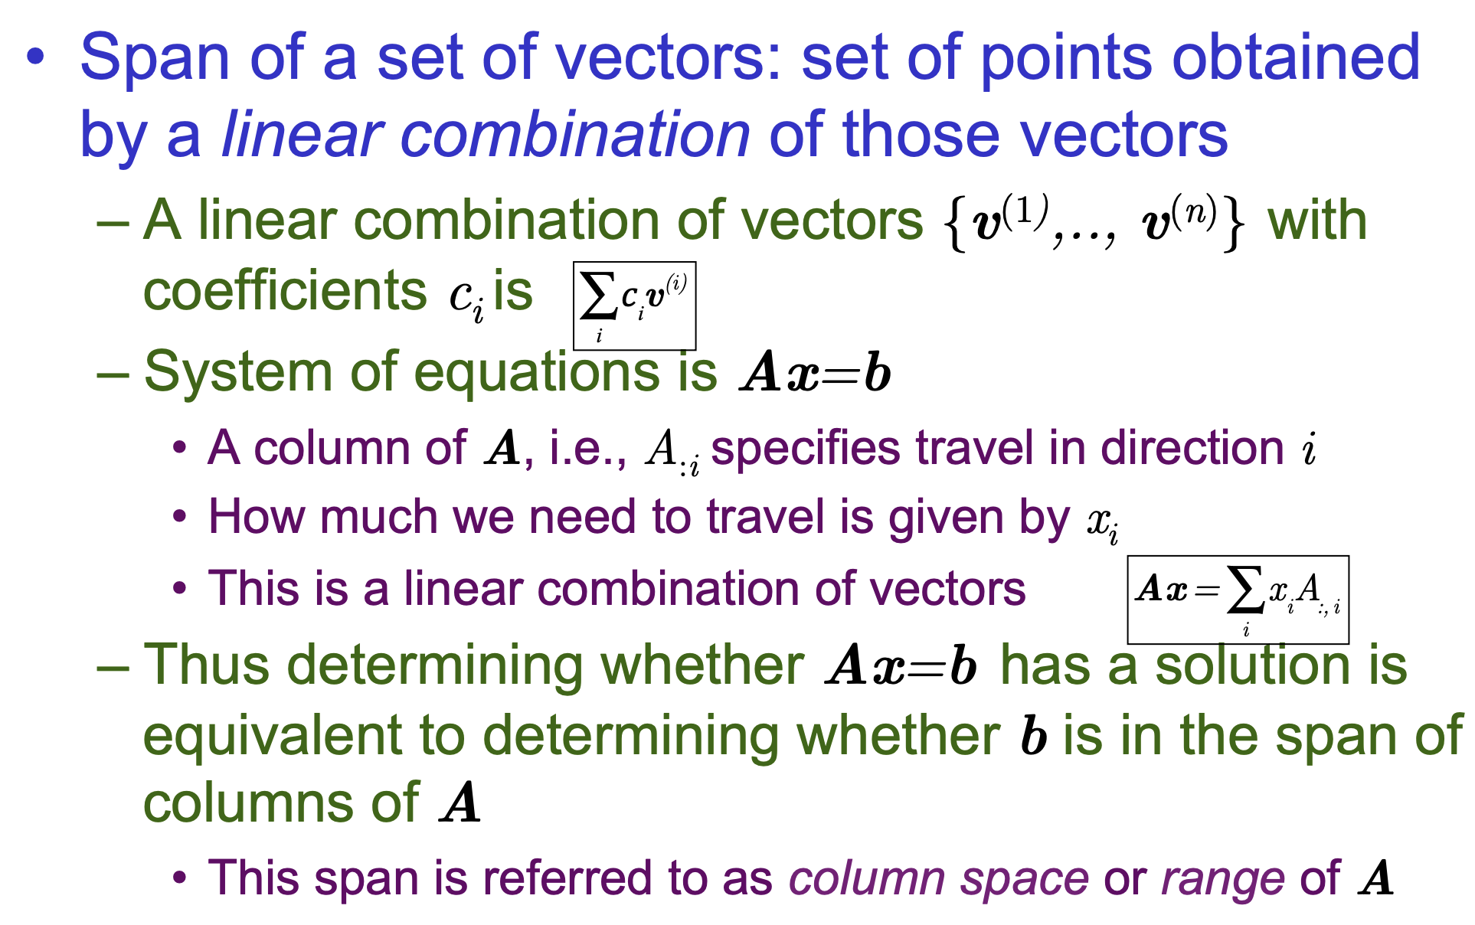
Span of a set of vectors

Slide 18
Span of a set of vectors
If you have one nonzero vector in R²
Its span is a line through the origin in the direction of that vector.
If you have two linearly independent vectors in R²
Their span is the entire plane R²
If you have two linearly independent vectors in R³
Their span is a plane through the origin in R²
If you have three linearly independent vectors in R³
Their span is the whole 3D space.
Connection to Machine Learning
The span tells us what subspace of the input space can be represented by a set of vectors.
In regression, for example, the span of the feature vectors determines what outputs can be represented exactly.
In PCA, the top k eigenvectors span the low-dimensional subspace used for dimensionality reduction.
In short: The span is the “space you can reach” by combining vectors. It’s like the coverage area formed by scaling and adding your vectors together.

Slide 19
Linearly dependent/independent
Linear Independence
A set of vectors (or matrix columns) is linearly independent if no vector can be written as a linear combination of the others.
Example: In ℝ², vectors (1,0) and (0,1) are independent.
Linear Dependence
A set of vectors (or matrix columns) is linearly dependent if at least one vector can be expressed as a linear combination of others.
Example: In ℝ², vectors (1,2) and (2,4) are dependent because (2,4) = 2 × (1,2).
Matrix Perspective
Columns (or rows) of a matrix are independent if the rank = number of columns (or rows).
If rank < number of columns, then some columns are dependent.

Slide 20
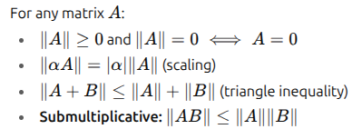
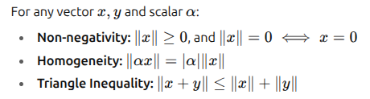
Norm
Definition
A matrix norm is a function that assigns a non-negative value (size/length) to a matrix, similar to vector norms.
A norm is a function that measures the length or magnitude of a vector.
Properties of a Norm

Slide 21
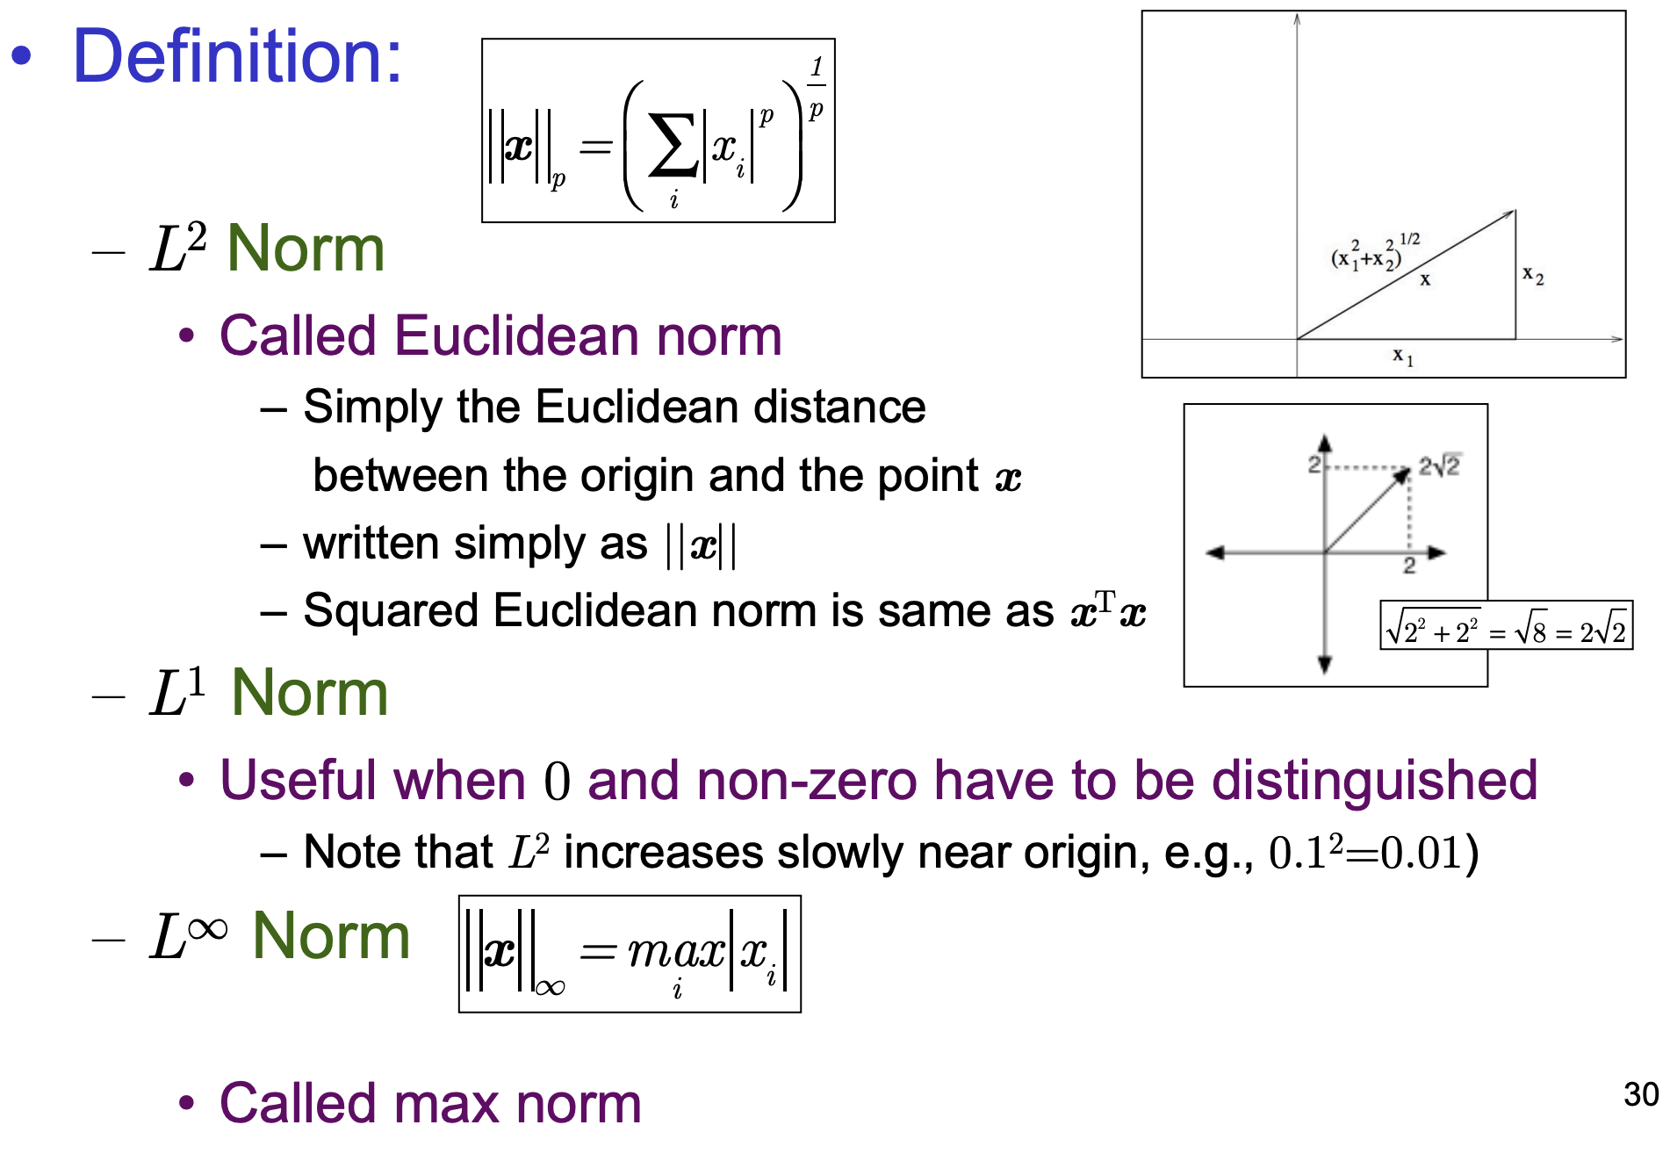
L^{P} Norm

Slide 22
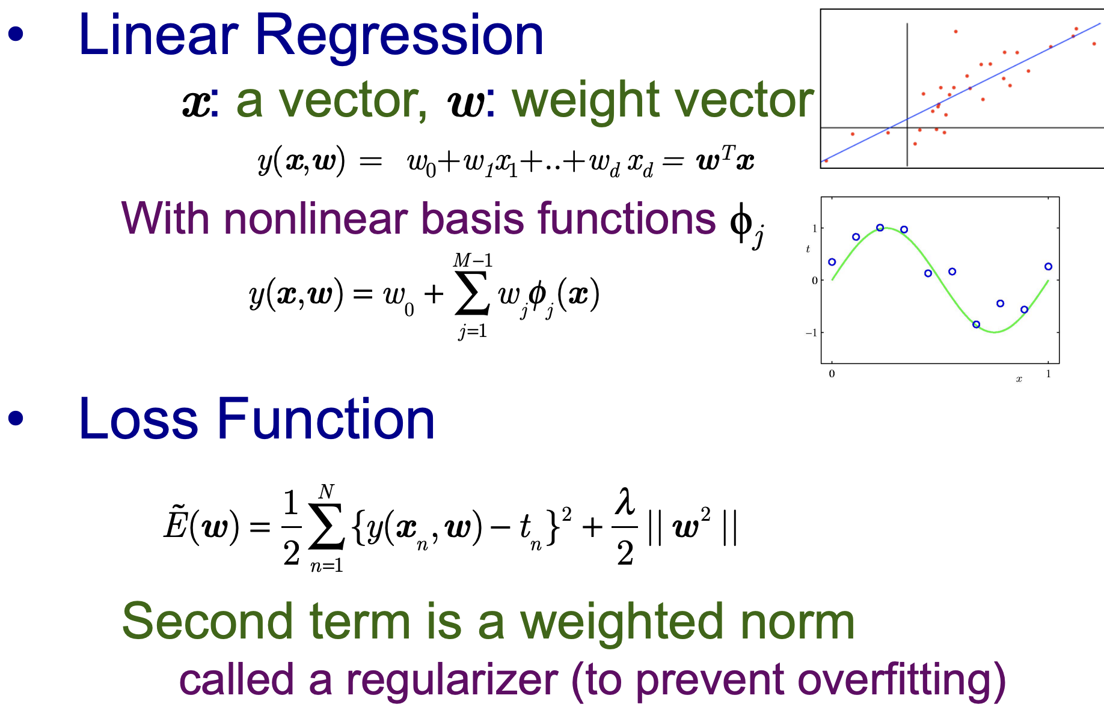
Use of norm in Regression

Slide 23
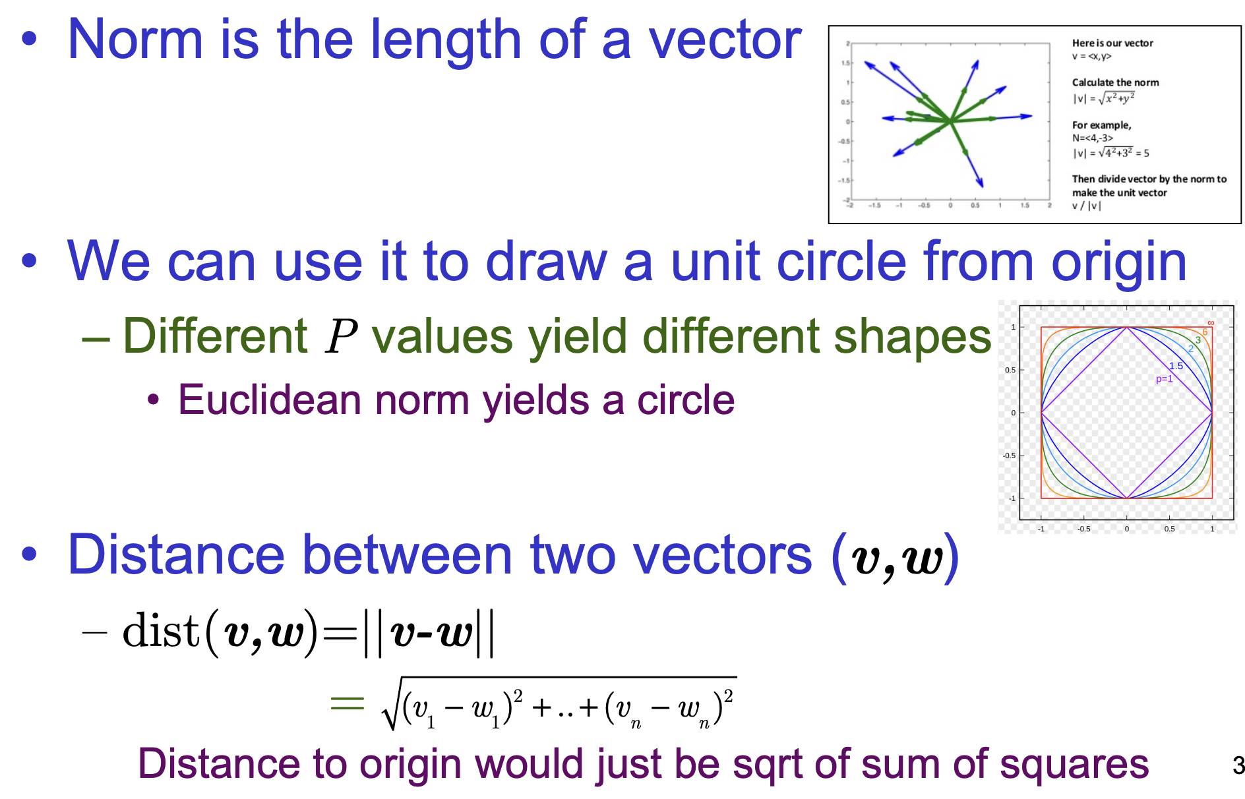
L^{P} Norm and Distance

Slide 24
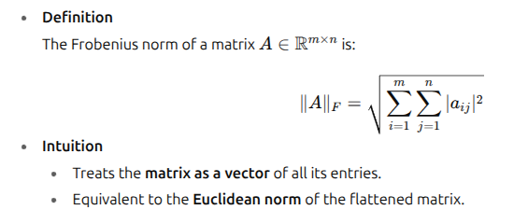
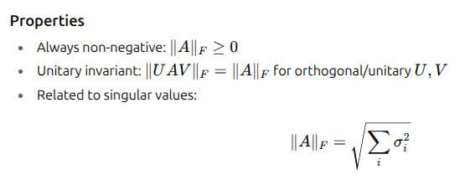
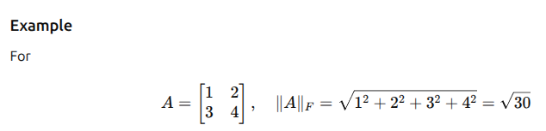
Size of a Matrix

Slide 25
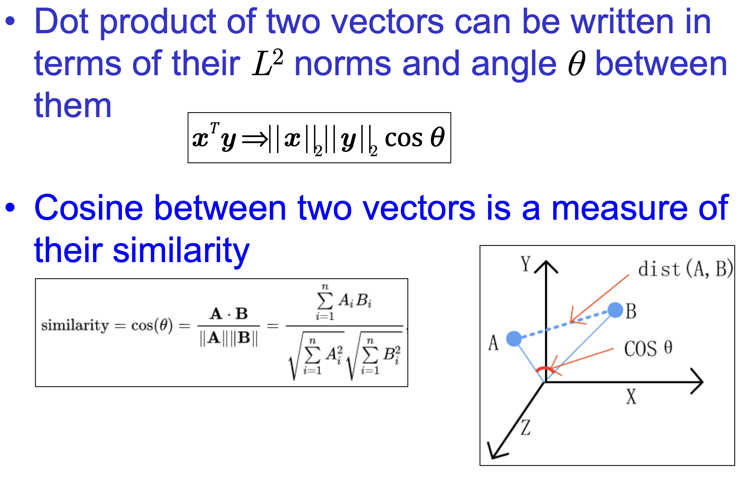
Angle between Vectors

Slide 26
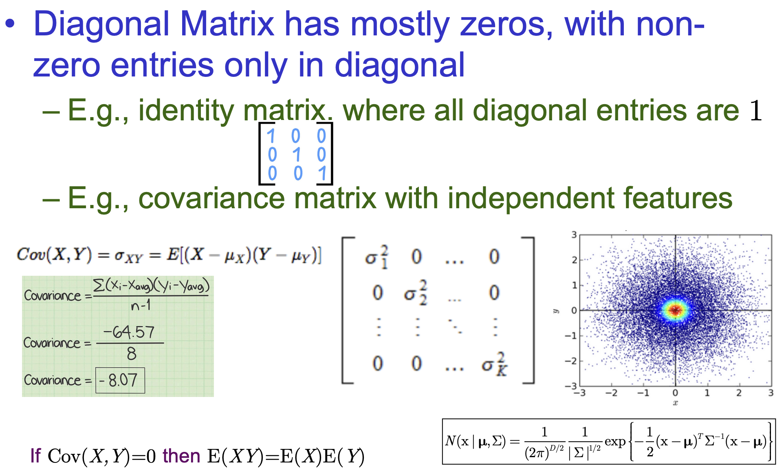
Special kind of Matrix: Diagonal

Slide 27
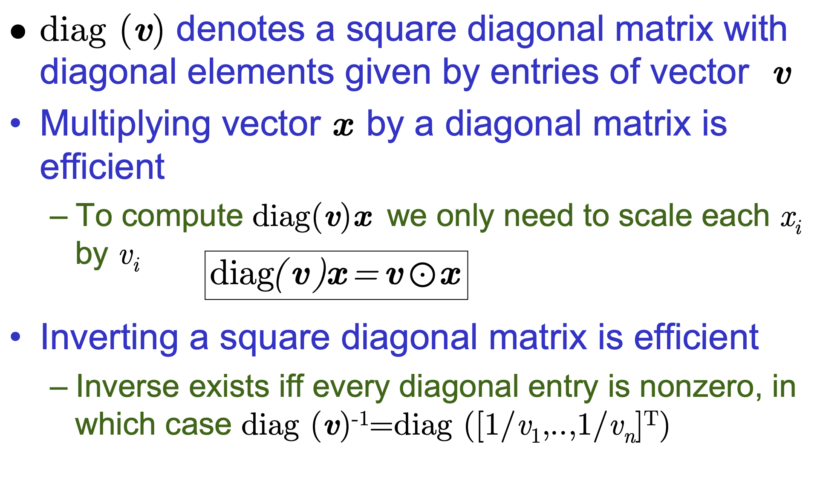
Efficiency of Diagonal Matrix

Slide 28
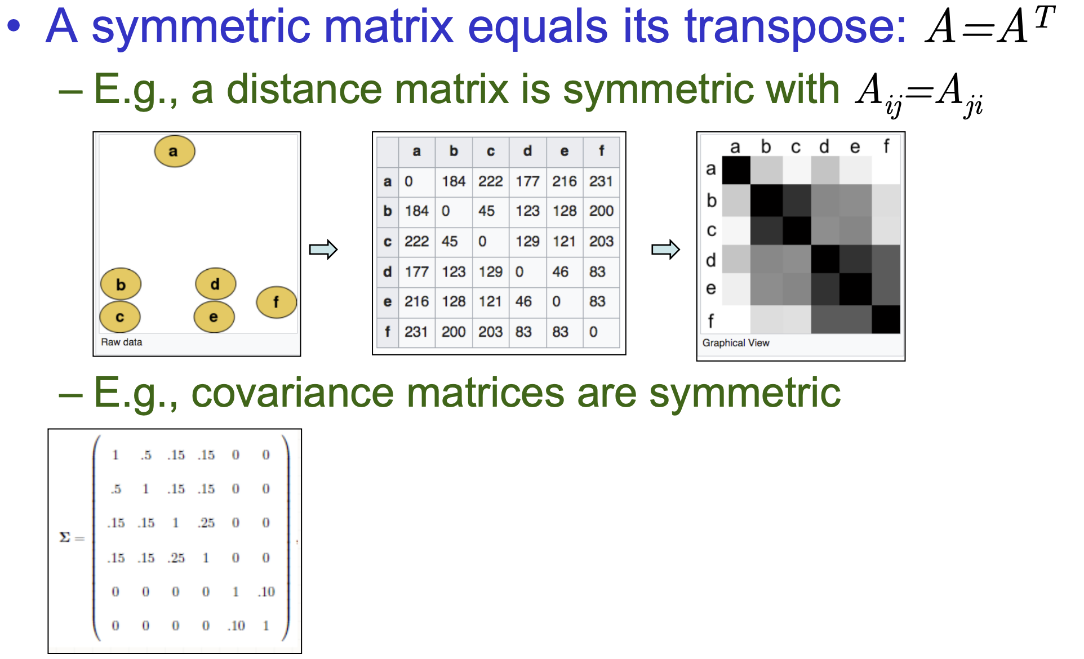
Symmetric Matrix

Slide 29
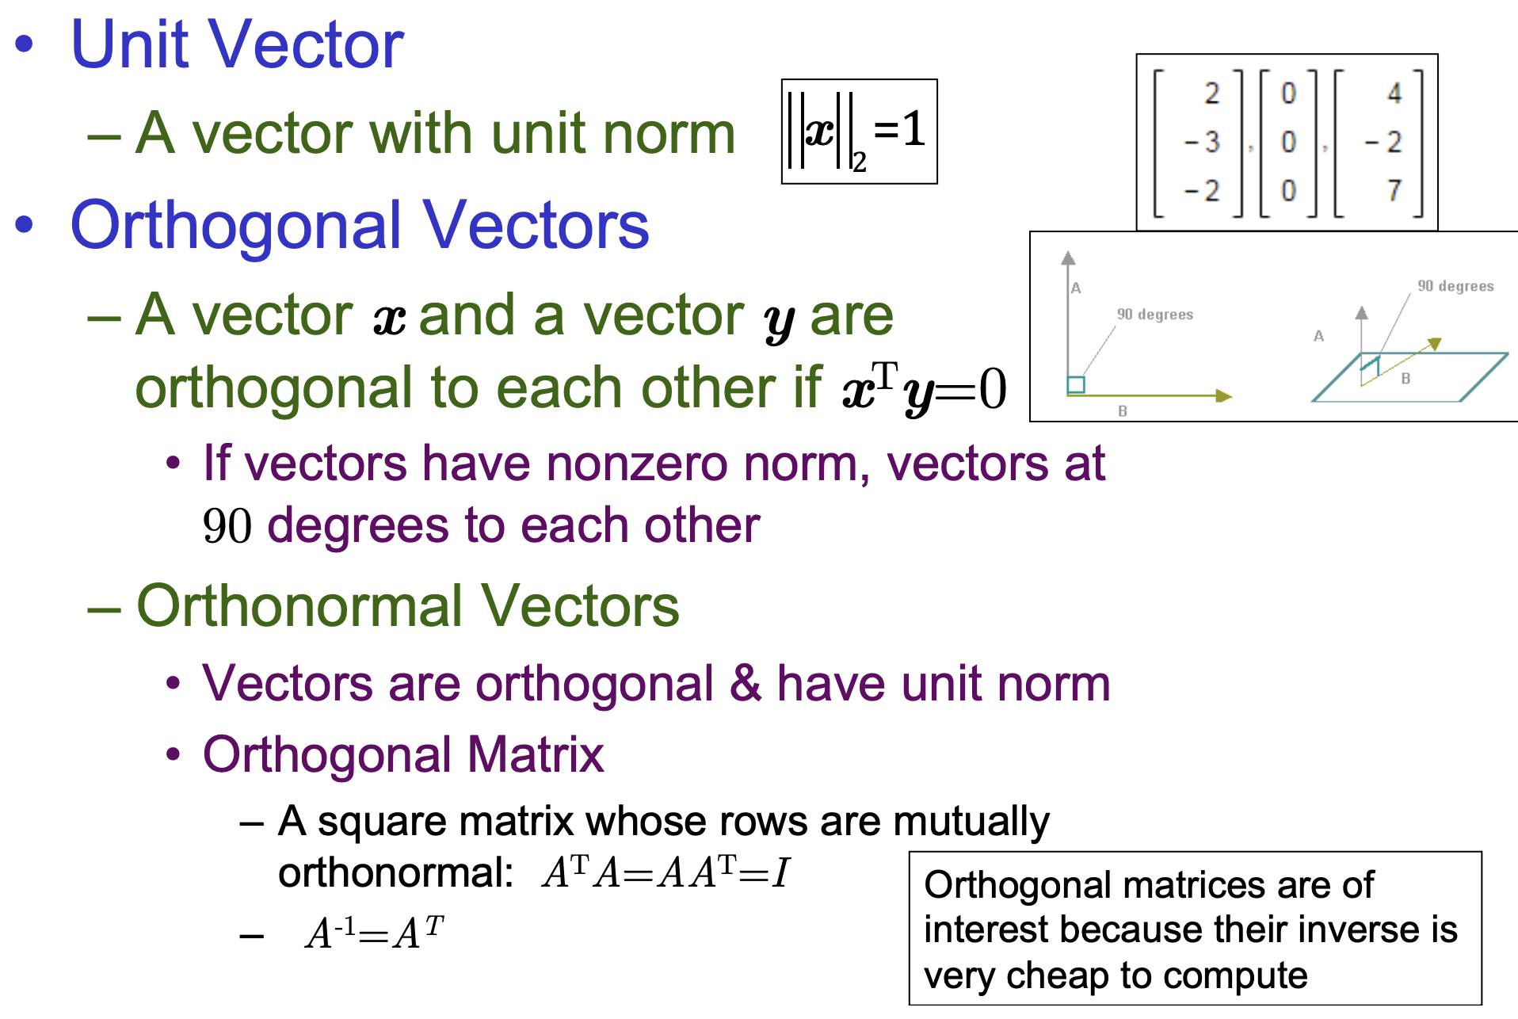
Special Kinds of Vectors

Slide 30
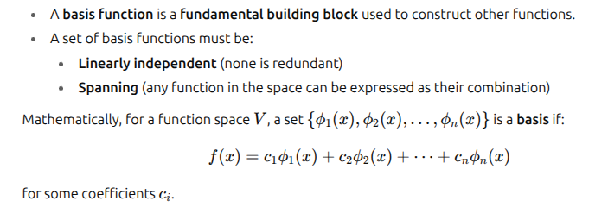
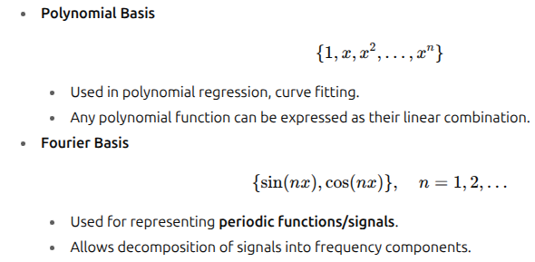
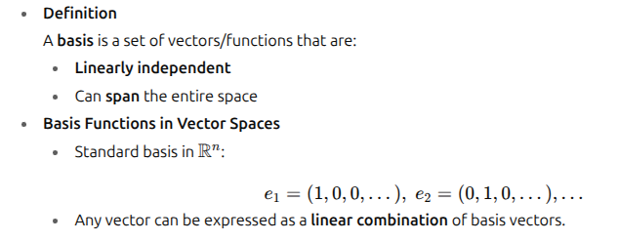
Basis
Vector basis: Coordinates in finite dimensions.
Function basis: Building blocks for infinite-dimensional function spaces.

Slide 31
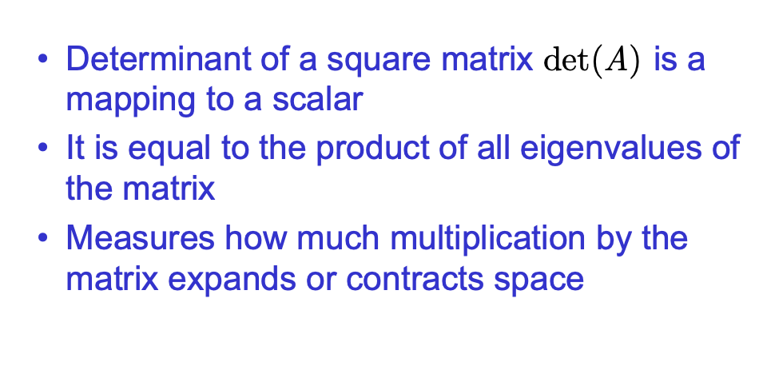
Determinant of a Matrix

Slide 32
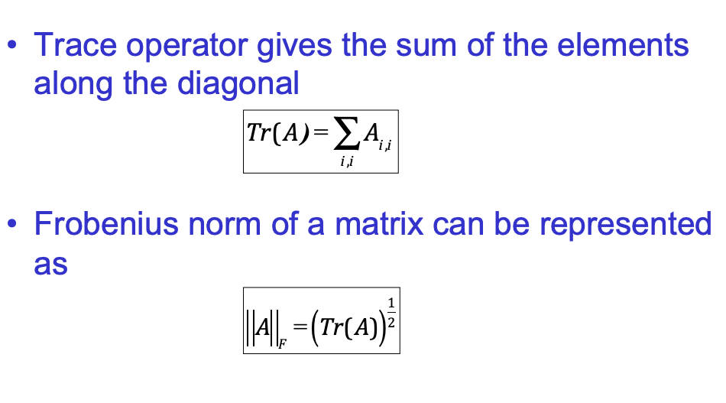
Trace of a Matrix

Slide 33
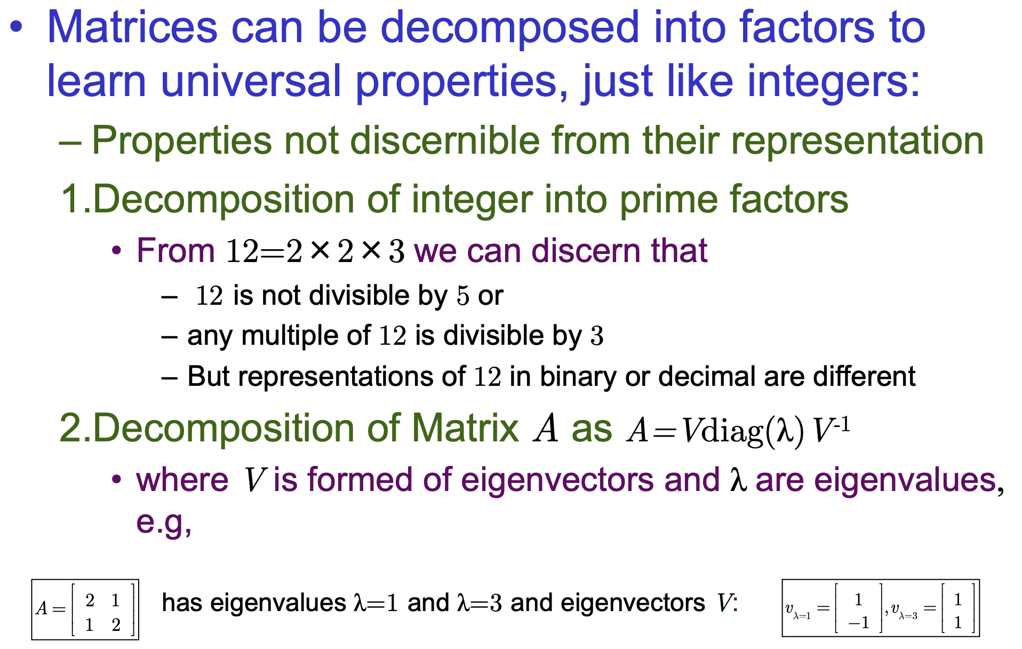
Matrix Decomposition

Slide 34
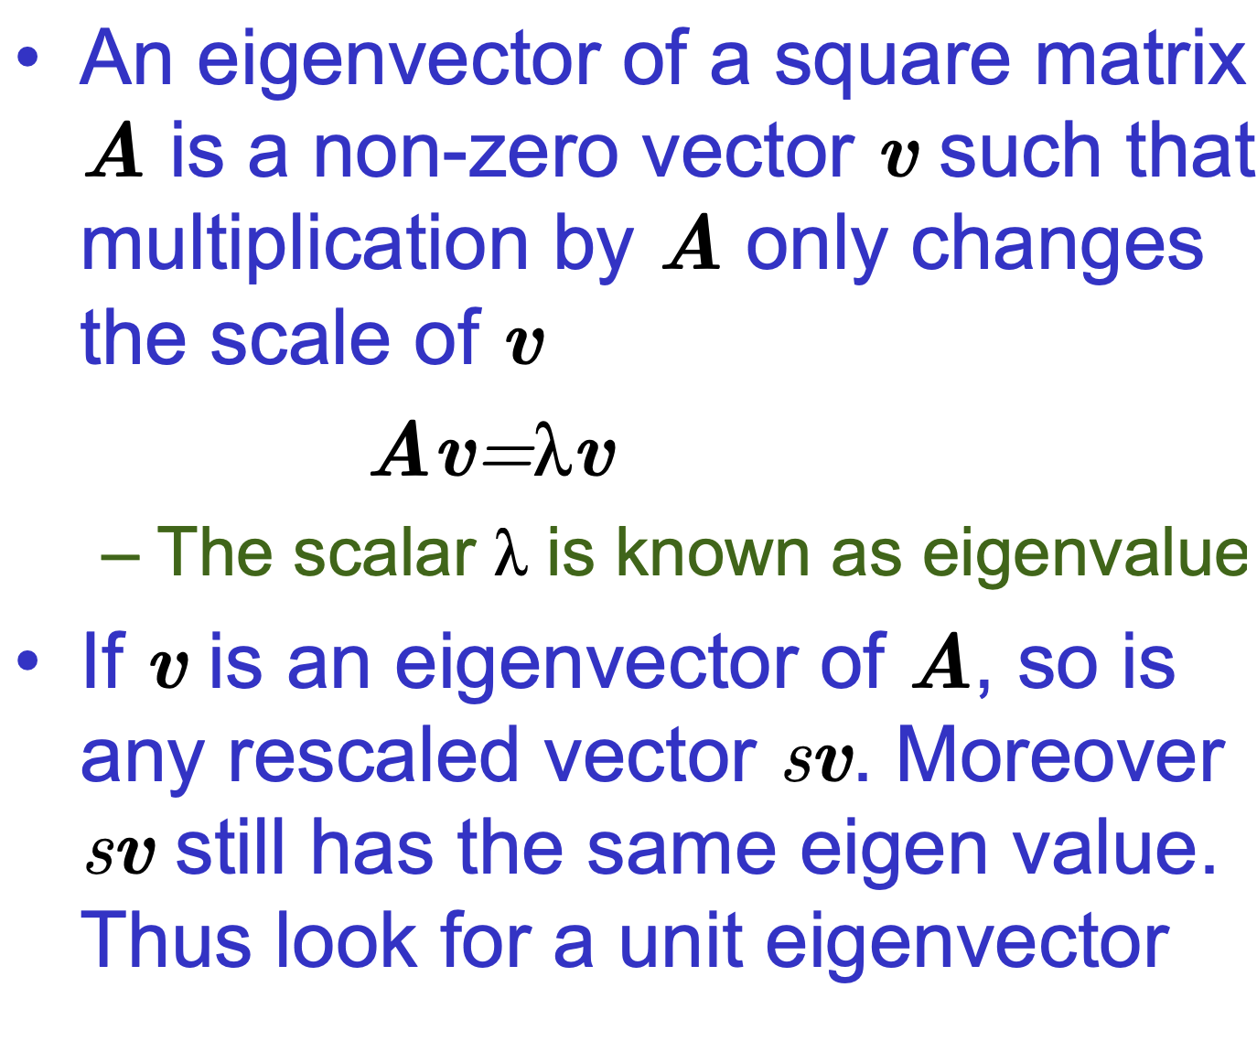
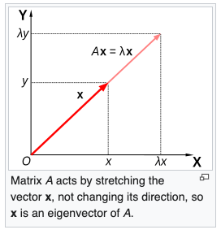
Eigenvector

Slide 35
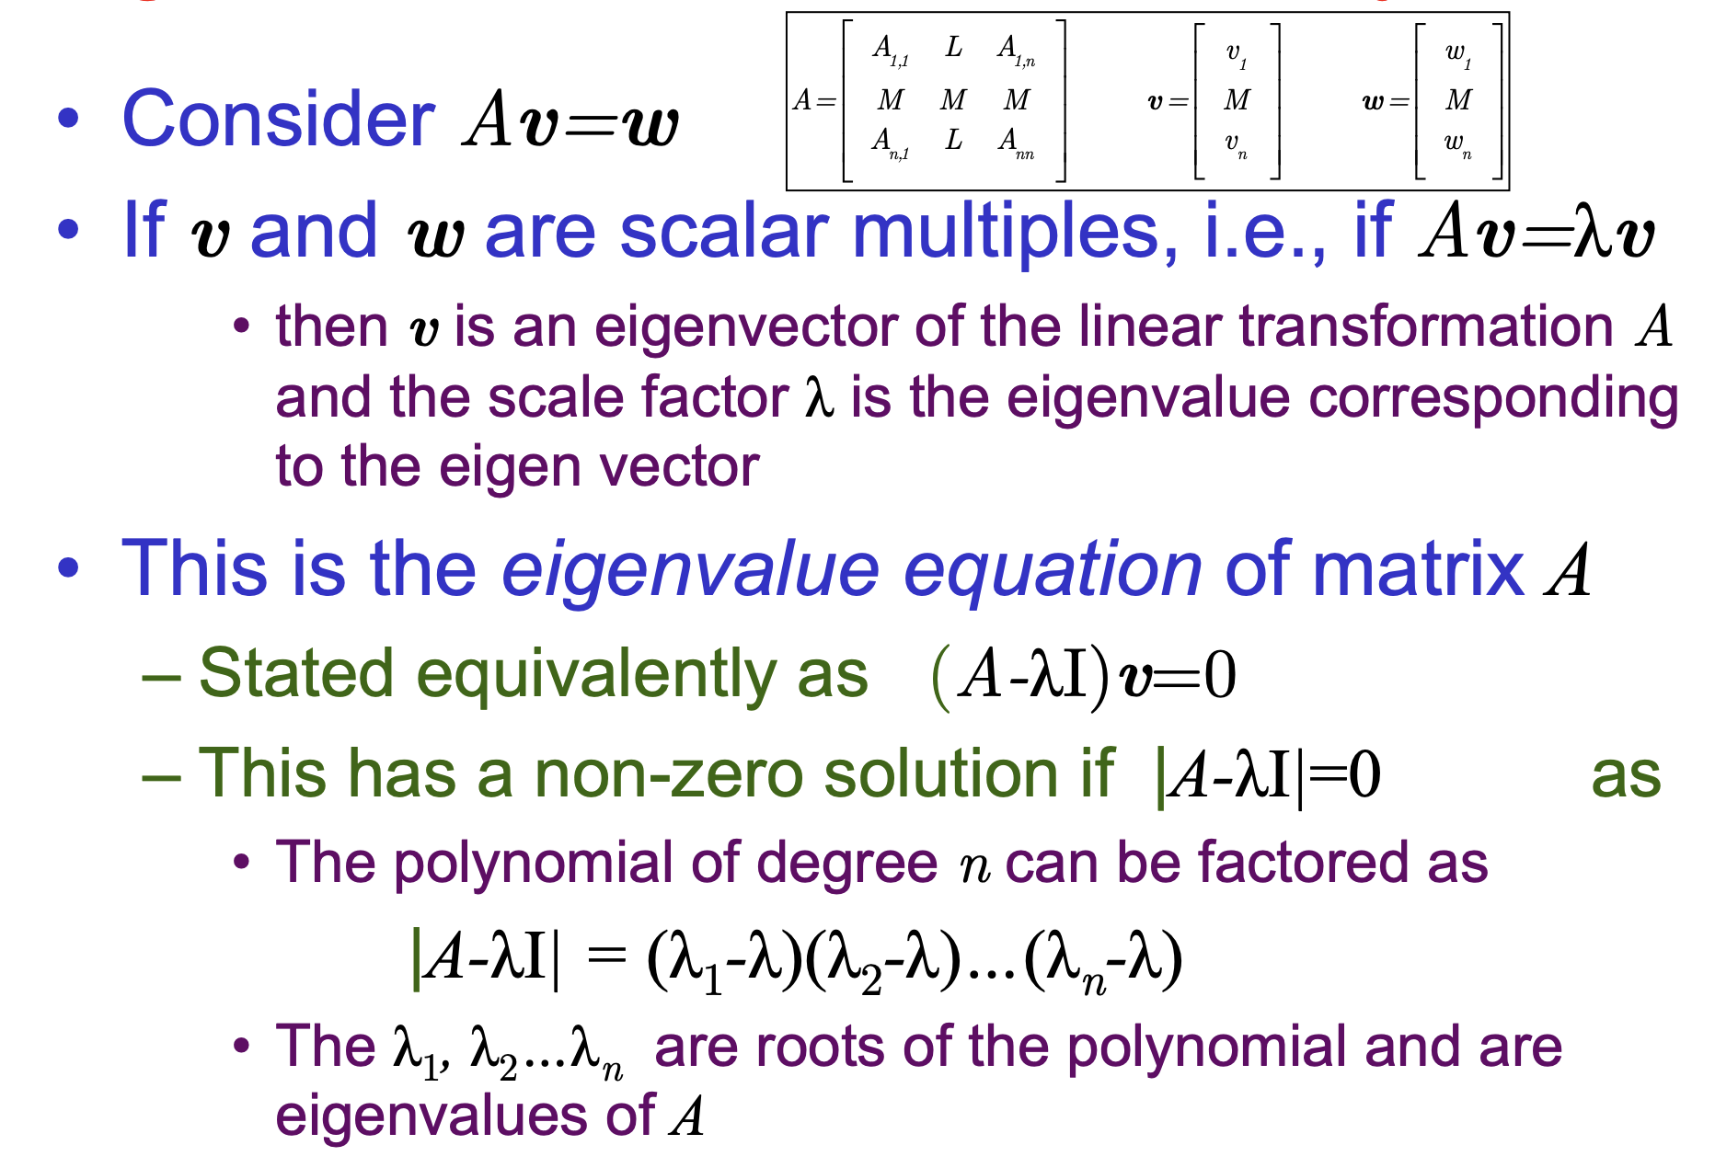
Characteristic Polynomial

Slide 36
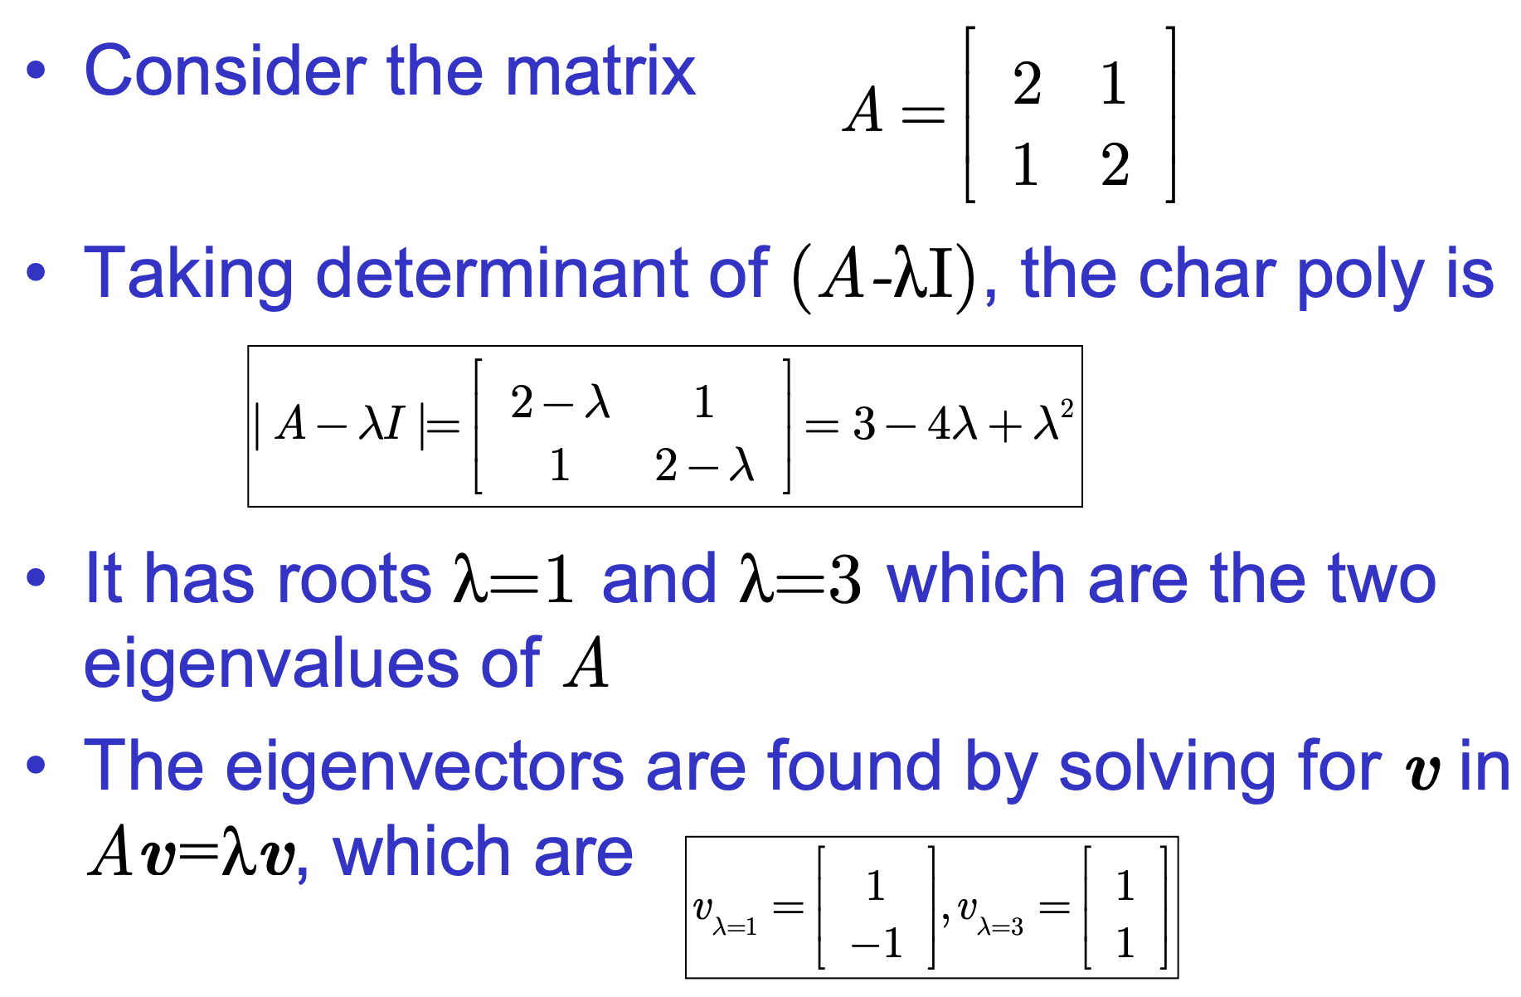
Eigenvalue/Eigenvector

Slide 37
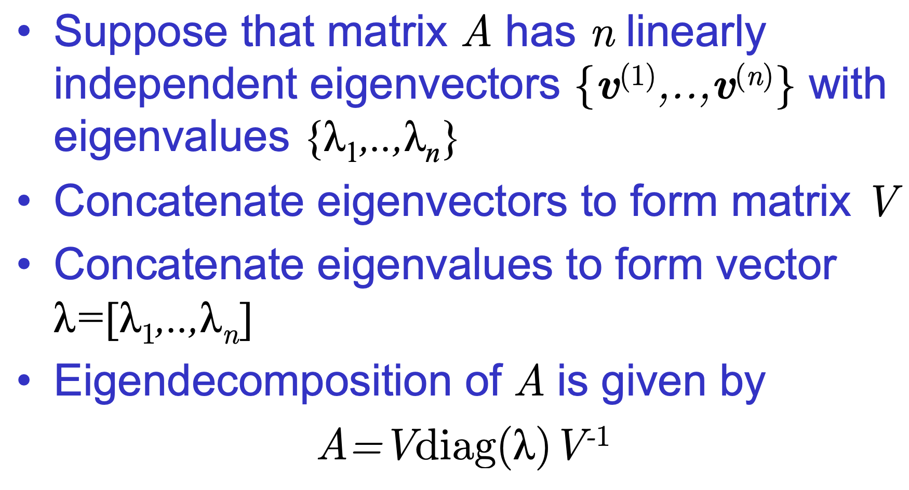
Eigen decomposition

Slide 38
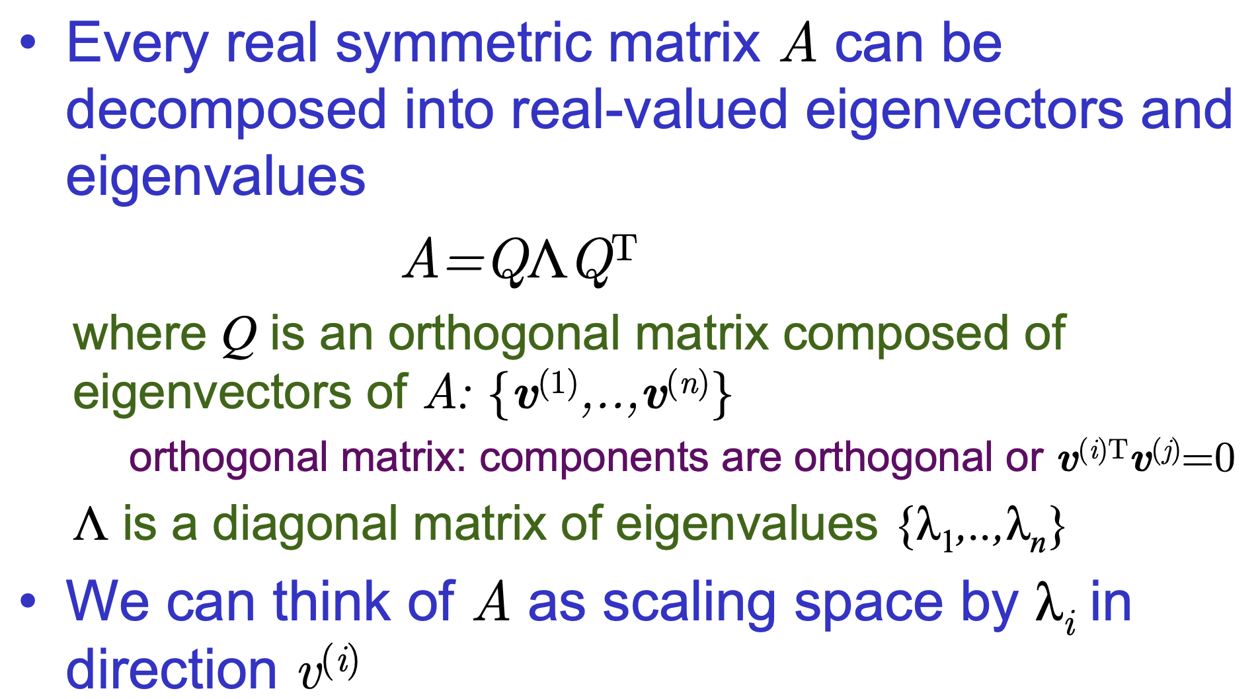
Decomposition of Symmetric Matrix

Slide 39
Why do we learn eigen decomposition?
Matrix Simplification
Makes powers & exponentials of matrices easier.
Example: A^{k}=VΛ^{k}V⁻¹.
Dimensionality Reduction
Basis of Principal Component Analysis (PCA).
Extracts dominant features by keeping largest eigenvalues.
Data Analysis & ML
Spectral clustering, topic modeling, covariance analysis.
Engineering & Physics
Vibration modes, stability of dynamical systems.
Quantum mechanics (state decomposition).
Graph Theory
Eigenvalues/eigenvectors of adjacency or Laplacian matrices reveal community structure.

Slide 40
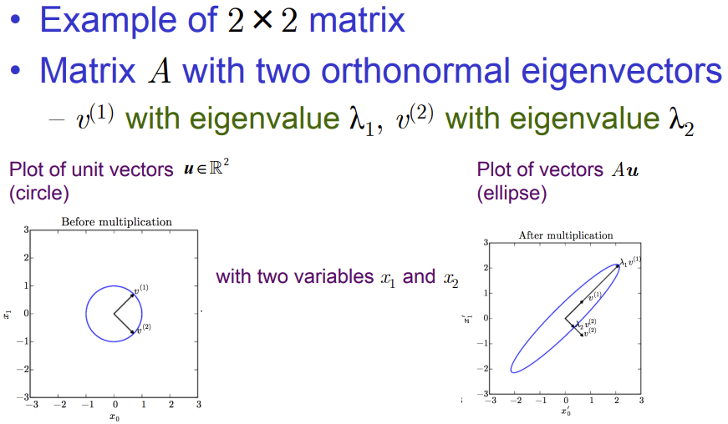
Effect of Eigenvectors and Eigenvalues

Slide 41
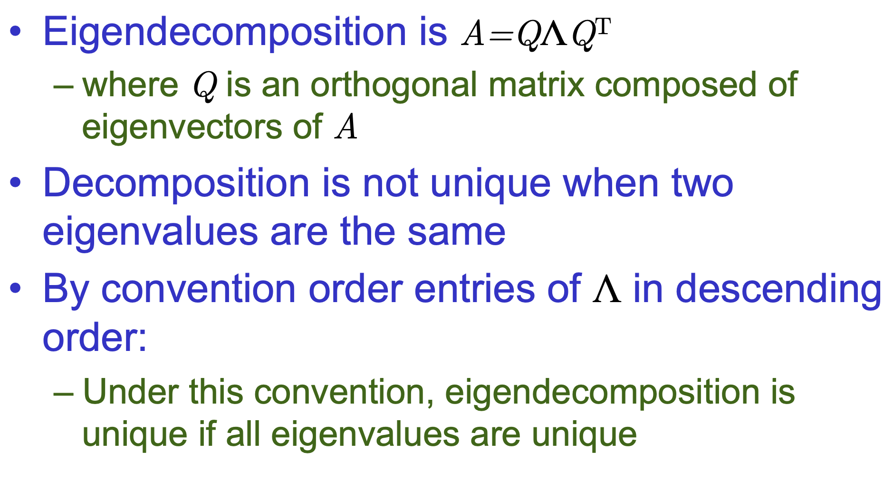
Eigen decomposition is not unique

Slide 42
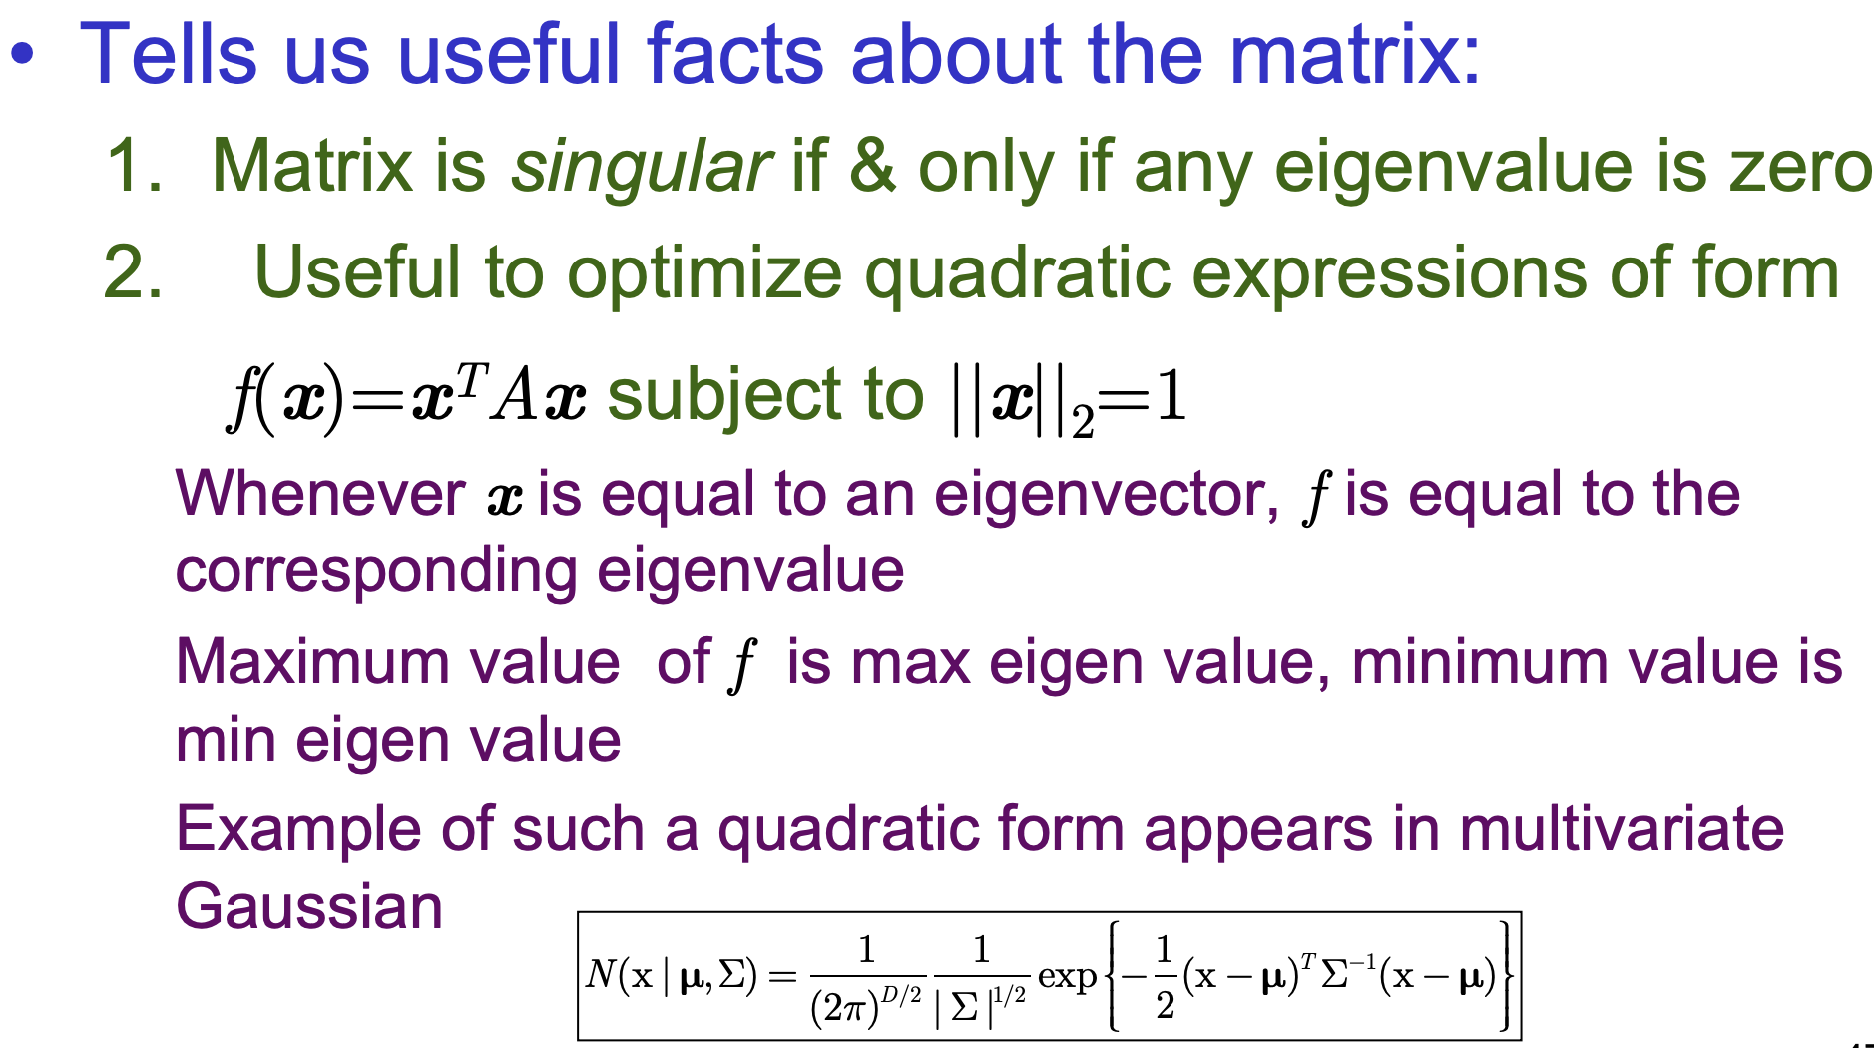
What eigen decomposition tell us

Slide 43
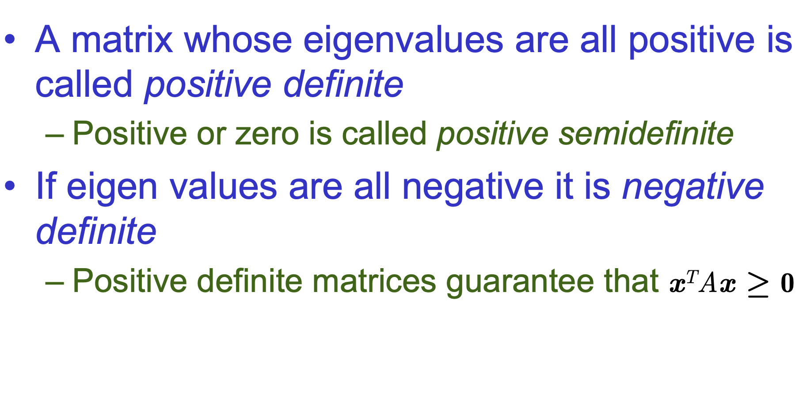
Positive Definite Matrix

Slide 44
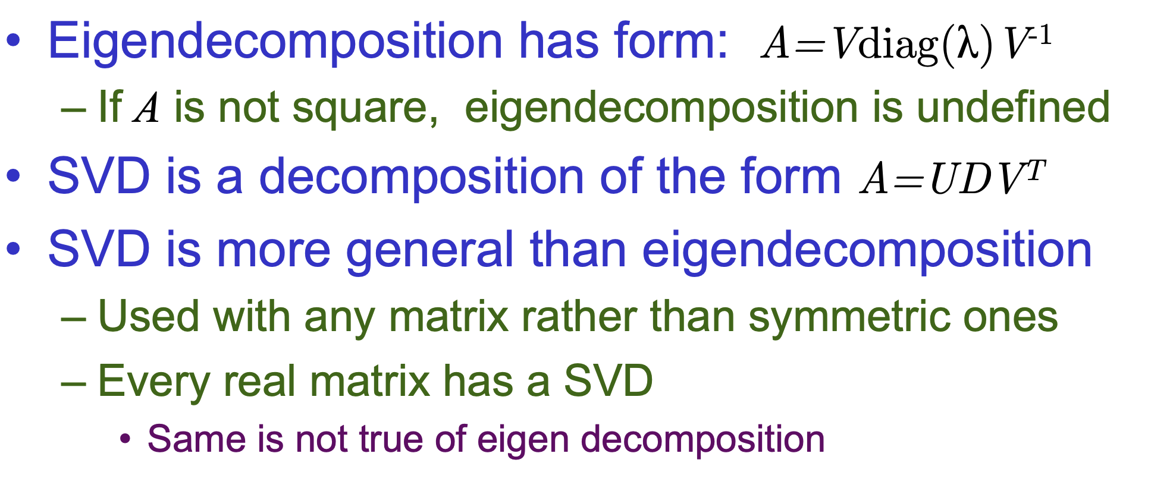
Singular Value Decomposition (SVD)

Slide 45
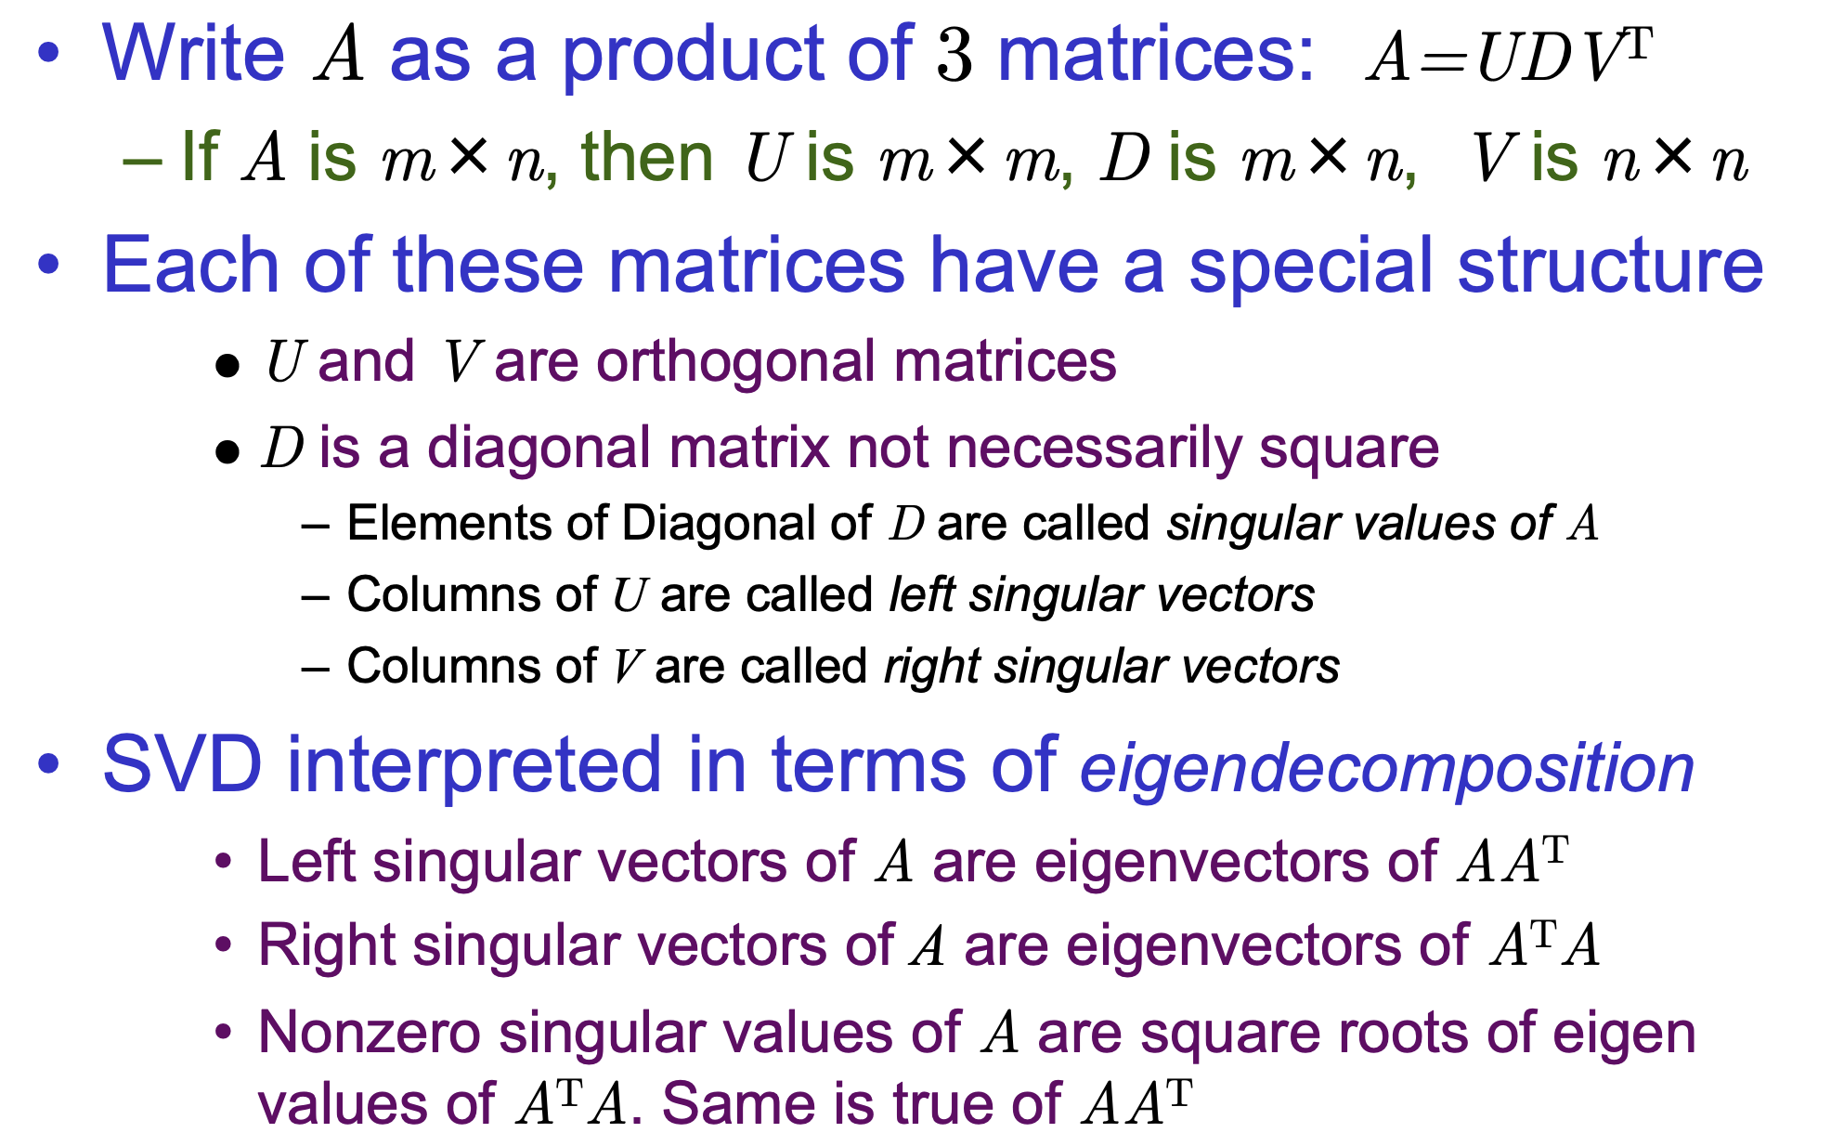
SVD Definition

Slide 46
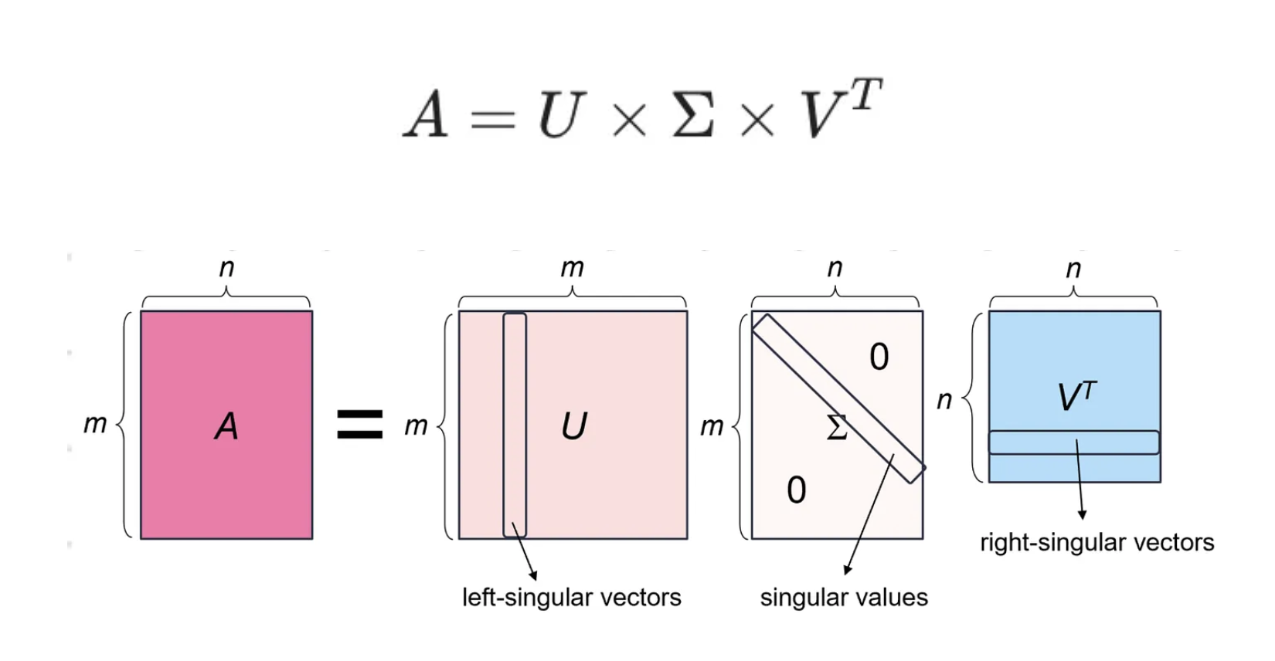
SVD

Slide 47
SVD Another Interpretation
Singular Value Decomposition (SVD) is a factorization method in linear algebra that decomposes a matrix into three other matrices, providing a way to represent data in terms of its singular values.
SVD helps you split a user-item table into three parts:
U: This part talks about the people (like their general preferences).
Σ/D: This part shows how important each factor is (how much each rating matters).
Vᵀ: This part tells you about the products (how similar they are to each other)
SVD breaks a user-(liked) movie into three smaller parts: one that shows people’s preferences, one that shows the importance of each movie, and one that shows how similar the movies are to each other

Slide 48
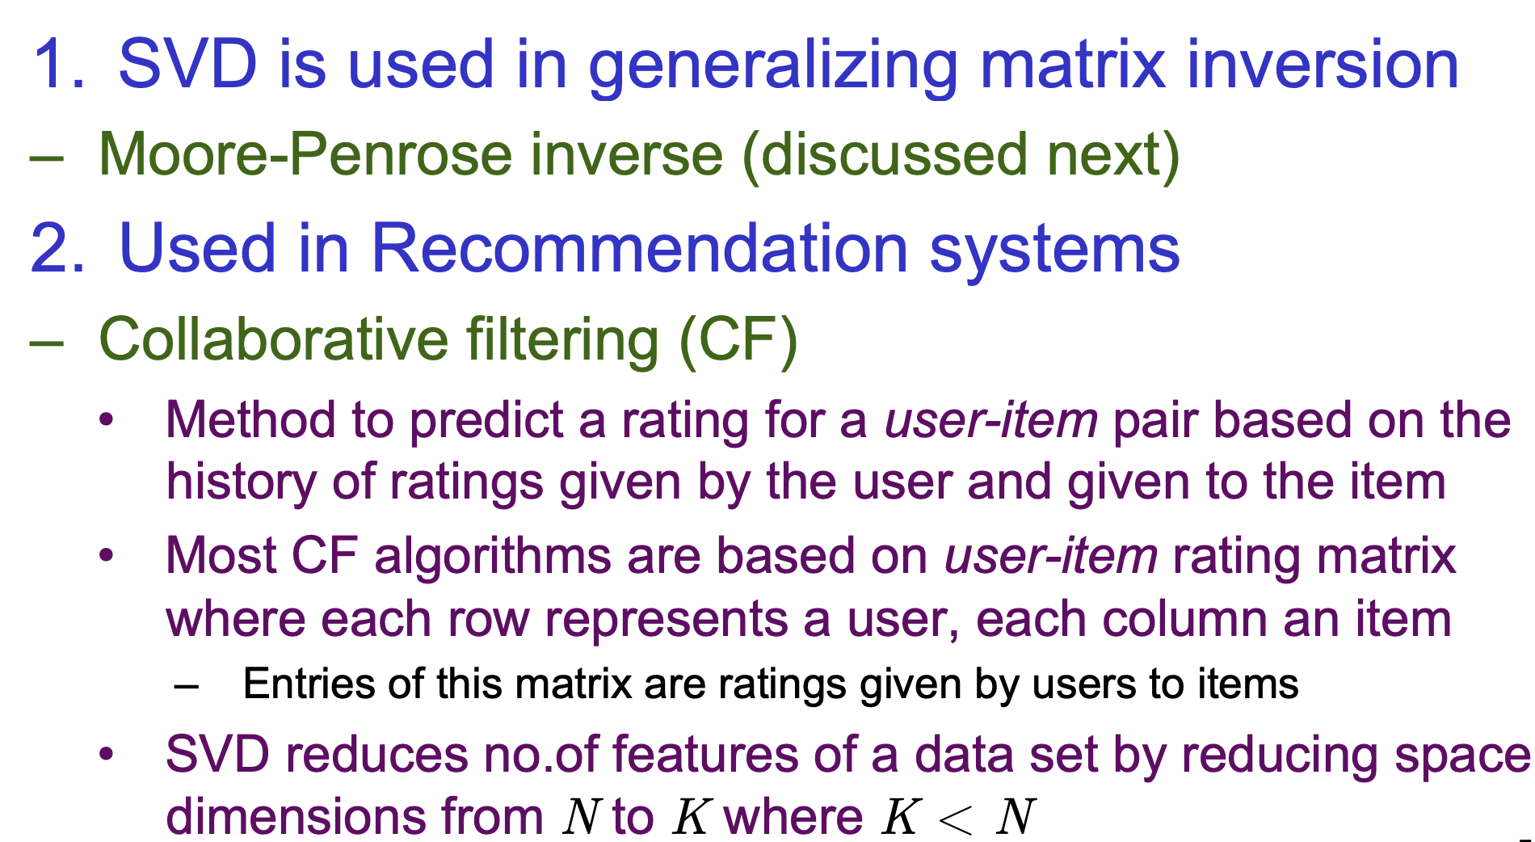
Use of SVD in ML

Slide 49
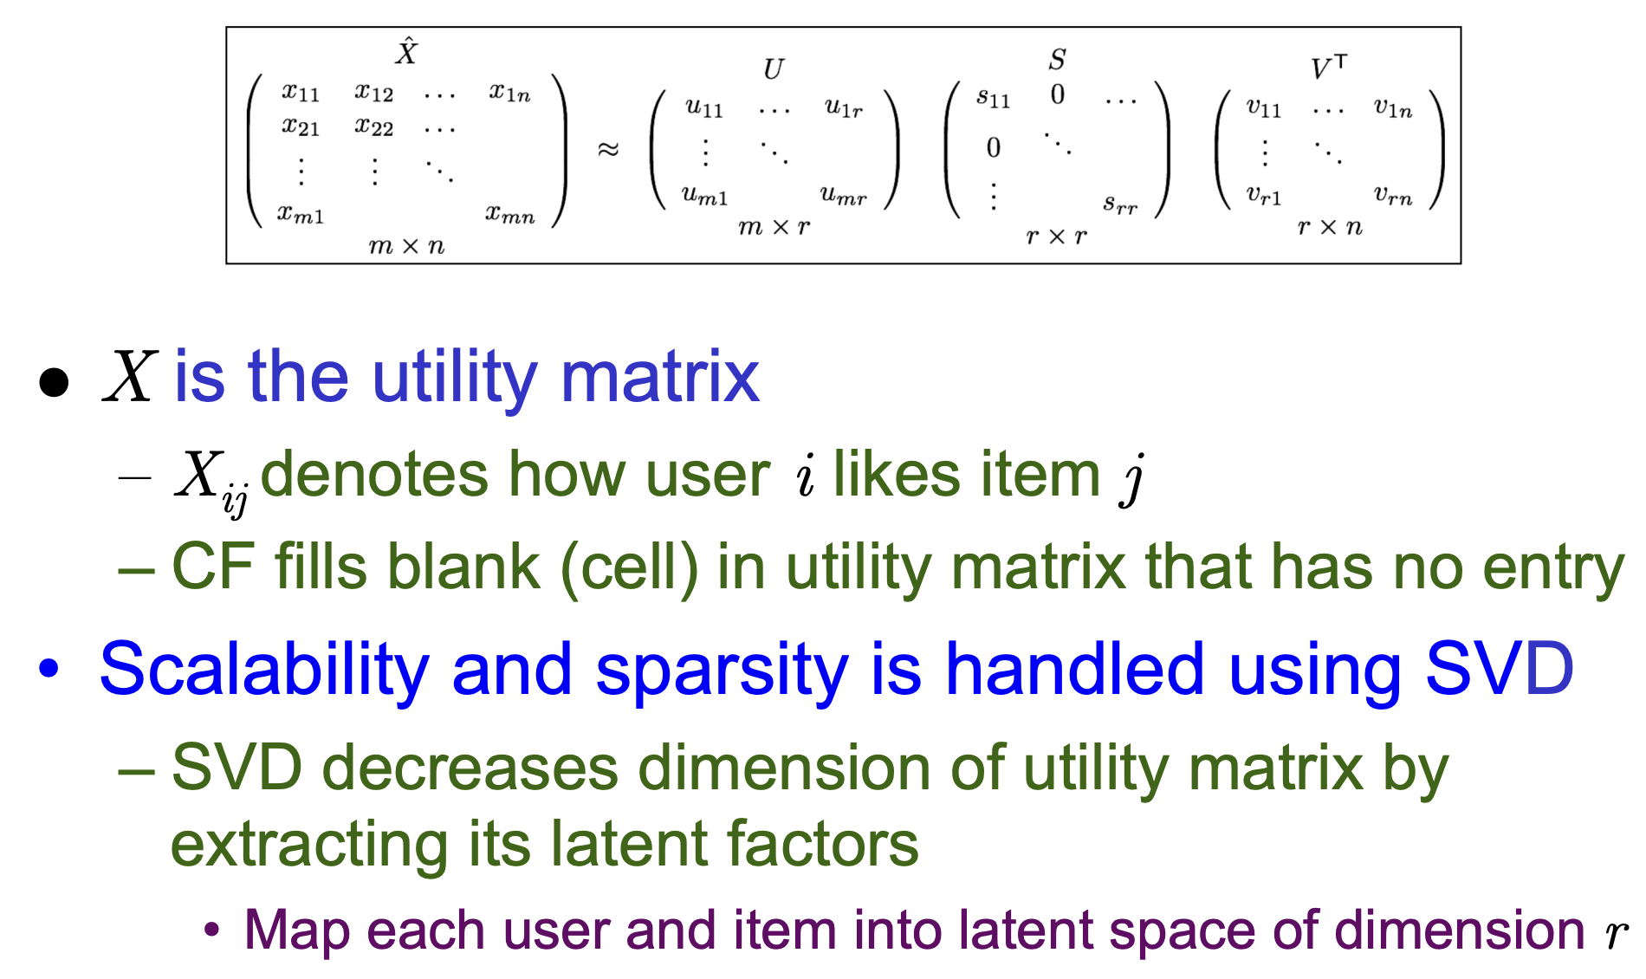
SVD in Collaborative Filtering

Slide 50
Use of SVD
Noise reduction (denoising): Keeping only the top k singular values often removes noise (random fluctuations) that tends to be captured by the smaller singular values.
This helps clean and stabilize the underlying signal.
Recommender systems: Services like Netflix and Amazon use SVD-based methods to predict movies or products you may like.
They factor a large user × item matrix to uncover hidden structure (latent features) that links users with similar preferences.
Dimensionality reduction (PCA): Principal Component Analysis (PCA)—a core machine-learning technique for simplifying high-dimensional data—can be computed directly using SVD.
Search engines (LSI): Latent Semantic Indexing (LSI) applies SVD to discover relationships between terms and documents
For example, a search engine infer that a query for “car” may also match documents about “automobile.”

Slide 51
PCA
PCA (Principal Component Analysis) is an unsupervised method for dimensionality reduction.
It reduces a dataset with many (often correlated) variables into a smaller set of new variables - called principal components - while preserving as much of the overall variance (information) as possible.
Each principal component is a linear combination of the original variables.
PC1 captures the largest amount of variance, PC2 captures the next largest (and is orthogonal to PC1), and so on: PC1 > PC2 > PC3 > … in terms of variance retained.

Slide 52
PCA and Feature Selection
PCA is not a feature selection method; it is a feature extraction (feature combination) method.
Feature selection keeps a subset of the original columns (e.g., choose columns 2, 5, and 9) and discards the rest.
PCA creates new features called principal components (PCs). Each PC is a weighted linear combination of the original features:
PC₁ = w₁x₁ + w₂x₂ + ... + w_{d} x_{d}
So instead of picking a few existing columns, PCA mixes information from many (often all) columns to form components that capture maximum variance.
Important note: A PC can have some weights close to zero (meaning some features contribute very little), but PCA still does not “select” features in the usual sense—theoretically it transforms the feature space into a new one.

Slide 53
PCA Methodology
Step 1: Standardize the features
Scale each column (e.g., using z-score standardization) when features have different units or magnitudes, so no single feature dominates the results. Since PCA requires numeric input, convert categorical variables into dummy/one-hot encoded variables.
Step 2: Compute the covariance matrix
Compute the covariance matrix of the standardized features to understand how variables vary together.
Why the covariance matrix? Covariance quantifies the relationship between two variables:
Positive covariance: they tend to increase/decrease together.
Negative covariance: one tends to increase when the other decreases.
Near zero: little to no linear relationship.

Slide 54
PCA Methodology
Step 3: Compute eigenvalues and eigenvectors of the covariance matrix.
Eigenvectors represent special directions in the data where the covariance matrix acts only as a scaling (stretching/shrinking)—not as a rotation—along that direction. These directions become the principal component axes.
Eigenvalues indicate how much variance is captured along each eigenvector (larger eigenvalue means more variance).
Step 4: Derive the principal component features
Project the standardized data onto the eigenvectors to obtain the principal component (PC) features. In practice, this is done by taking the dot product of the standardized feature matrix with the selected eigenvectors, producing the PC scores (e.g., PC1, PC2, …).

